Slide 1
Assessing Evaluation Procedures Using Text Processing With Python
Shretij Kapoor

Slide 2
Problem Statement
Activist groups worldwide present summary statements at the UN, advocating for causes like human rights and environmental protection. This project seeks to answer the following key questions:
What are the key themes and argumentation styles used by activist groups at the UN?
Are there noticeable regional patterns in the way these groups frame their arguments?
How can activist groups optimize their argumentation strategies for global advocacy?

Slide 3
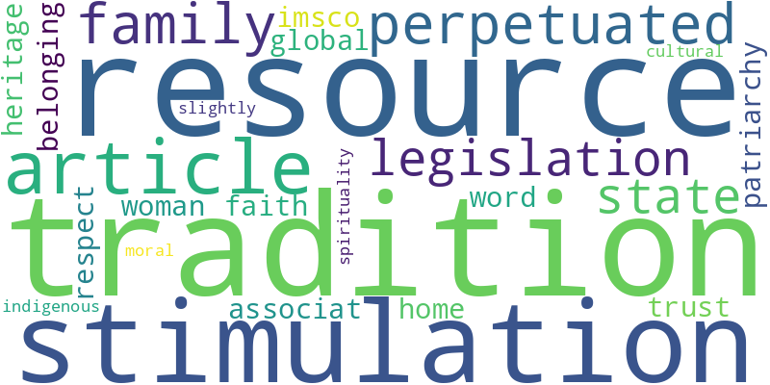
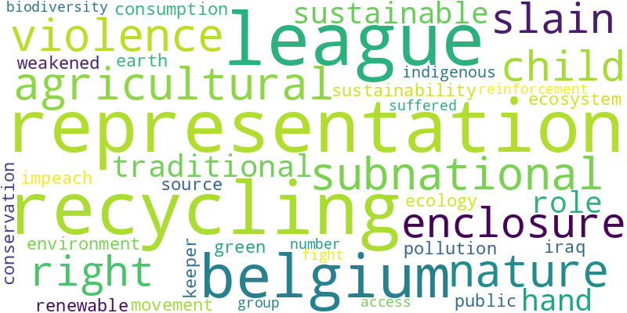
Orders of Worth Keywords
  Grouping words based on societal orders (e.g., Civic, Domestic, Industrial).
  Using Word2Vec to find similar words within each group.
Examples:

Slide 4
Project Overview
Extracting text from PDFs
Segmentation based on page numbers
Text preprocessing and NLP techniques
Word2Vec model for word embeddings
Topic modeling using Corex

Slide 5
Methodology: Data Extraction
I used PyPDF2 and fitz (PyMuPDF) libraries to extract text from the PDF files.
A custom function was written to process each PDF, ensuring clean and consistent text extraction.
Noise (e.g., headers, footers) was filtered out using regex, ensuring only meaningful text was retained.

Slide 6
Methodology: Text Summarization
A text-rank algorithm was applied to extract key sentences and summarize each document.
Summarization focused on capturing the core arguments and themes presented by each activist group.
Manual adjustments were made to ensure that the summaries accurately reflected each group's position.

Slide 7
Methodology: Contextual Similarity Analyses
Arguments were categorized into different types, including Environmental, Reputation-based, and Domestic advocacy.
Text analysis techniques like term frequency-inverse document frequency (TF-IDF) were applied to identify recurring themes.
Correlations between regions and argumentation styles were discovered.

Slide 8
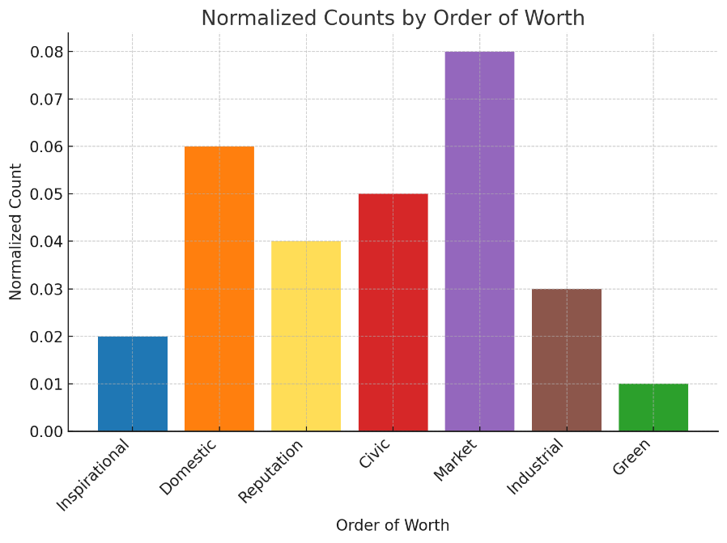
Normalized Counts of Keywords by Order
A bar chart showing the normalized frequency of each 'Order of Worth' category across the entire dataset. This helps visualize how much each value system (e.g., environmental, civic, market-based) is emphasized across the activist statements.

Slide 9
Key Findings:
Argumentation Styles: The analysis revealed interesting patterns:
South Asian Groups: Frequently focused on reputation issues, linking national concerns with global frameworks, especially in human rights discussions. These groups emphasized rank and distinction rather than kinship or genealogy when addressing caste-related issues.
Latin American and Iraqi Groups: Found intriguing connections between ecological and interpersonal violence, highlighting an emerging narrative in their activist efforts. While the dataset is small, these connections offer valuable insight into evolving activist discourse.

Slide 10
Recommendations
Employ Multimodal Argumentation: Blend local and global issues for stronger advocacy.
Avoid Stereotypical Framing: Experiment with non-traditional argumentation strategies to appeal to a broader audience.
Research Successful Strategies: Learn from groups that have diversified their argumentation styles for more effective advocacy.

Slide 11
Conclusion and Future Work
Summarized the process of extracting and analyzing PDF text.
Successfully implemented Word2Vec and Corex for word similarity and topic modeling.
Future work could explore the evolution of these strategies over time and their impact on policy outcomes.

